Slide 1

“Terapie di seconda linea”
Undicesima Giornata Fiorentina
dedicata ai pazienti con
malattie mieloproliferative
croniche
Sabato 17 maggio 2025
Massimo Breccia
Sapienza Università
Roma

Slide 2
PV patients who do not respond to available treatments represent the sub-segment with the highest unmet need
77,2%
15,4%
Representing 11,8% of total PV population
PV patients
Patients on cytoreductive therapy (HU)
Res/intolerant to HU
2
Alvarez-Larran et al, Blood 2012, 119: 1363-69-; Alvarez-Larran et al, BJH 2016, Vol.172(5), p.786-793

Slide 3
Resistance to hydroxyurea (HU) adversely affects survival and disease progression in PV
Overall survival
Transformation to post-PV MF&AL
1.0
HR: 5.6 (IC95%: 2.7-11.9)
1.0
HR: 6.8 (IC95%: 3.0-15.4)
0.8
0.8
0.6
0.6
Probability
Incidence
0.4
P <0.001
0.4
P <0.001
0.2
0.2
0.0
0.0
0
5
10
15
20
25
0
5
10
15
20
25
Years
Years
Resistance
Non resistance
Resistance
Non resistance
Resistance or intolerance to HU increase risk of death by more than 5 times
Resistance and intolerance to HU occurred in 13% and 11% of 261 PV patients
Intolerance to HU can be a reason to move patients to second-line therapy but does not entail any prognostic significance
Alvarez-Larrán A, et al. Blood. 2012;119(6):1363-1369.

Slide 4
Italian RWE: Study Population
Overall, 563 patients received HU for at least 12 months and were included in this analysis.
166 complete responders
(HU-CR)
(29.5%)
934 PV
patients
614 PV patients treated with HU
for ≥12 months
563 PV patients treated with HU for ≥12 month
397 POOR RESPONDERS
(70.5%)
320 PV patients
preliminarily excluded
51 PATIENT EXCLUDED:
HU STOP, followed by no therapy
or only busulfan/interferons
Partial response
264 (66.5%)
No response
133 (28.7%)
52:lack of 2016 WHO criteria
15: excess missing data
41: HU start before 2005
212: no or <12-month exposure to HU
HU-POOR
283 (71.3%)
HU-RUX
114 (28,7%)
Study flowchart. Number of individuals at each stage of the study.
26/04/24
CC10240256000
Notes:
Among the 934 PV patients included in the PV-NET database, 52, 15, 41 and 212 patients were excluded because their PV diagnosis did not meet the 2016 WHO criteria, because of excess missing data, because their HU therapy was prior to the discovery of the JAK2V617F mutation (2005), and because they had no or less than 12 months of exposure to HU, respectively. Additionally, 51 patients who never achieved CR to HU were excluded because they received no therapy or only busulfan/interferons after HU discontinuation.

Slide 5
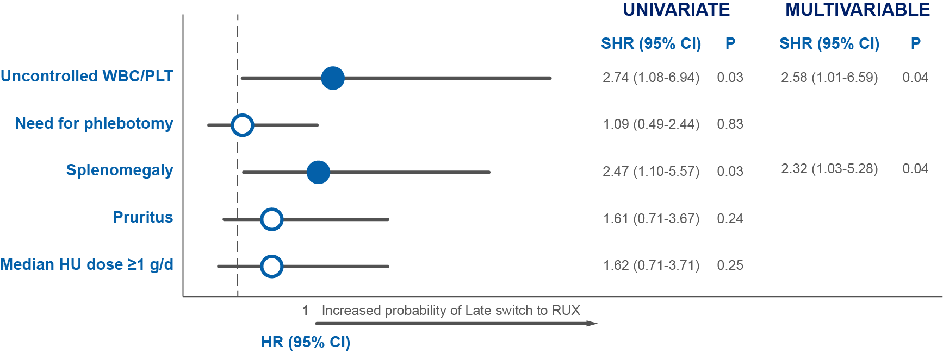
Factors associated with early switch
Blu dots indicate significant variables in both uni- and multivariate.
In the multivariable analysis, splenomegaly (p=0.04) was specifically associated with an early switch
26/04/24
CC10240256000

Slide 6
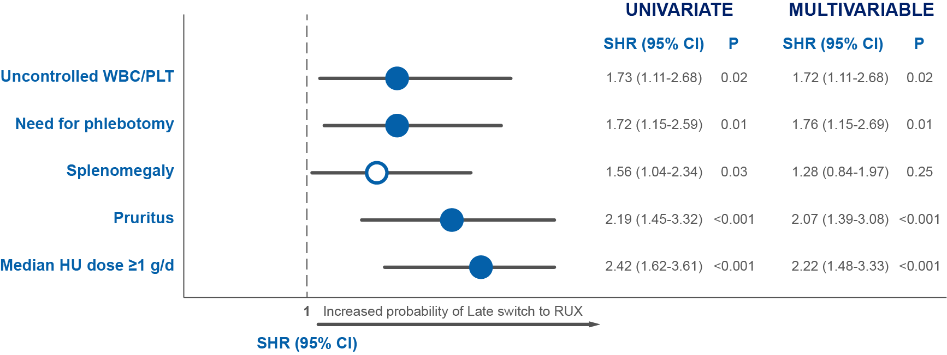
Factors associated with late switch
Blu dots indicate significant variables in both uni- and multivariate.
The need for phlebotomies (p=0.01), the median HU dose of ≥1 g/d (p<0.001), and pruritus (p<0.001) were specifically associated with a late switch
26/04/24
CC10240256000

Slide 7
2025: current therapies in PV
First line
Second line
Third line
Hydroxyurea
Ropeg IFNa2b
Ruxolitinib
Ropeg IFNa2b
Hydroxyurea
Ruxolitinib
Ropeg IFNa2b
Busulfan
Clinical trial
Marchetti et al Lancet Hematol 2022

Slide 8
RESPONSE studies: study designs
Ruxolitinib
10 mg BID
Extended treatment phase
RESPONSE¹
Resistance or intolerance to HU (modified ELN criteria)
Phlebotomy requirement
Splenomegaly
n = 110
Week 208
N=222
Pre-randomization (Day −28 to Day −1)
Hct 0.40-0.45
Crossover to ruxolitinib
Randomized (1:1)
Week 208
BAT
n = 112
Week 48
Week 80
Week 32
(primary endpoint)
Controllo HCT < 45% + Riduzione ≥ 35% del volume della milza
RESPONSE 2²
Ruxolitinib
10 mg BIDª
Extended treatment phase
Resistance or intolerance to HU (modified ELN criteria)
Phlebotomy requirement
Nonpalpable spleen at screening and baseline
ECOG ≤ 2
n = 74
Week 260
N=149
Screening Period
(Day − 35)
Hct 0.40-0.45
Randomized (1:1)
Crossover to ruxolitinib
Week 260
BAT
n = 75
Week 28
(primary endpoint)
Week 52
Week 80
ªStarting dose 10 mg bid; BAT, best available therapy;
ELN, European LeukemiaNet; Hct, hematocrit; HU, hydroxyurea
Controllo HCT < 45%
HU (at the maximum tolerated dose)
IFN or peg-IFN
Pipobroman
Anagrelide
Approved immunomodulators
Observation without pharmacologic treatment
BAT
Vannucchi AM, et al. N Engl J Med. 2015;372(5):426-435.
Passamonti F, et al. Lancet Oncol. 2017;18(1):88-99

Slide 9
Primary endpoint
Controllo HCT < 45% +
Riduzione ≥ 35% del volume della milza
Controllo HCT < 45%
RESPONSE: Composite at Week 32¹
  77% of patients randomized to ruxolitinib met at least 1 component of the primary endpoint
  91% of patients who achieved the primary endpoint had a confirmed response at week 48
RESPONSE 2: HCT Control at Week 28²
  Significantly more patients randomized to ruxolitinib achieved Hct control without phlebotomy compared with those randomized
  to BAT
Individual Components of Primary Endpoint
P < .0001
OR, 7.28
(95% CI, 3.43-15.45)
Primary Endpoint
P < 0.0001
OR, 28.64
(95% CI, 4.50-1206)
Patients. %
Vannucchi AM, et al. N Engl J Med. 2015;372(5):426-435.
Passamonti F, et al. Lancet Oncol. 2017;18(1):88-99

Slide 10
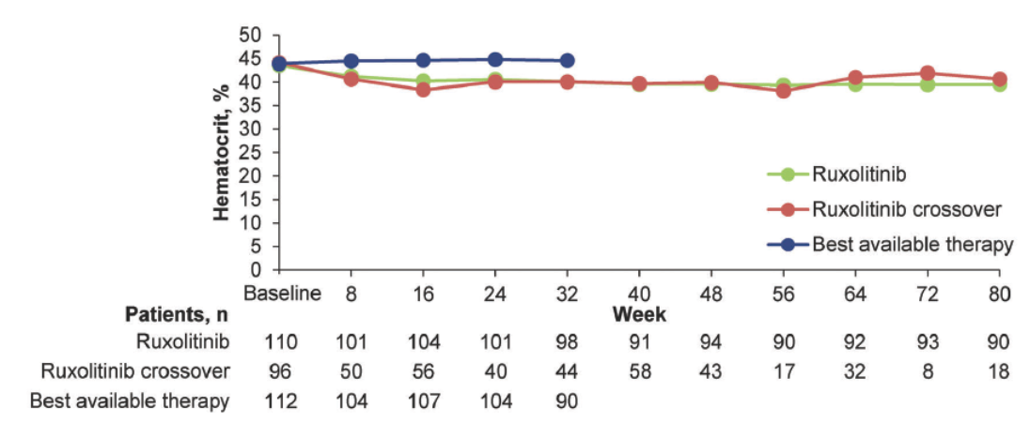
Ruxolitinib provide more consistent control of HCT to ≤ 45% than those who received BAT over time
Patients in the BAT arm spent 12 times more time (in percentage of time) with an HCT > 45% than patients in the ruxolitinib arm (median, 39.1% [quartile (Q) 1-Q3, 12.9%-65.9%] vs 3.0% [Q1-Q3, 0.0%-16.7%])
The mean change from baseline in HCT ranged from:
−3.12% to −4.36% in the RUX arm (from wk 12 to 80)
+0.06% and +1.03% in the BAT arm (from wk 12 to 32).
Verstovsek et al. Haematologica 2016 Volume 101(7):821-829

Slide 11
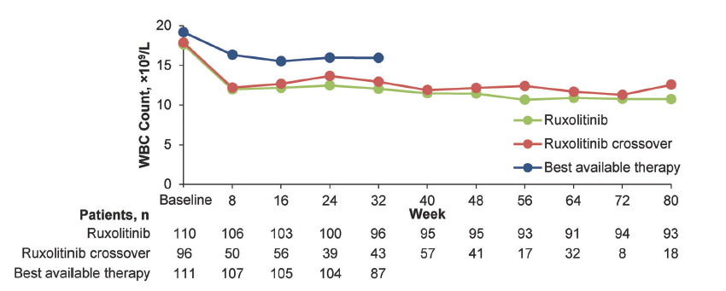
Ruxolitinib normalizes WBC count
RESPONSE
In comparison with BAT-treated patients, a higher proportion of ruxolitinib-treated patients had a WBC count ≤ 10 × 10⁹/L (40.9% vs 31.3%) at week 32
higher proportion of patients randomized to ruxolitinib had a WBC count ≤ 15 × 10⁹/L (70.0% vs 42.9%) at week 32
Patients with the highest WBC counts at baseline (Q4) had the largest reductions, with mean values in the ruxolitinib arm of approximately 15 × 109/L or lower from week 8 onward (BAT arm remained > 25 × 109/L)
Harrison EHA 2015 EP1353; Verstovsek et al. Haematologica 2016 Volume 101(7):821-829

Slide 12
Rate of phlebotomy procedure
Ruxolitinib lowers the need for phlebotomy and ameliorates markers of iron deficiency
RESPONSE: Up to Week 32¹
RESPONSE 2: Up to Week 28²
Patients. %
Vannucchi AM, et al. N Engl J Med. 2015;372(5):426-435.
Passamonti F, et al. Lancet Oncol. 2017;18(1):88-99

Slide 13
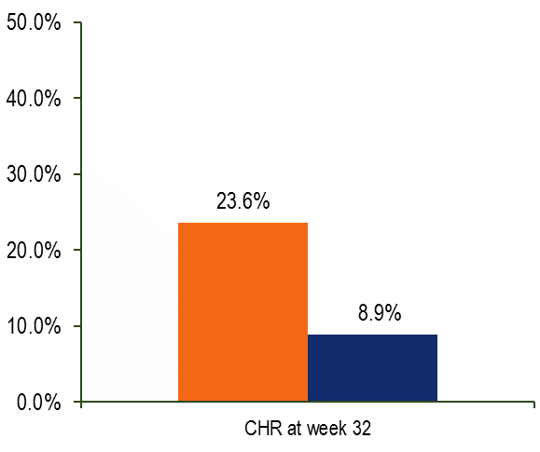
Secondary endpoint. Complete hematologic remission
CHR is defined as HCT control, PLT count ≤ 400 x 10⁹/L, and WBC count ≤ 10 x 10⁹/L.
RESPONSE¹ at Week 32
  88.5% of patients (23/26) who achieved CHR maintained it at week 48
RESPONSE 2² at Week 28
  Significantly more patients randomized to ruxolitinib achieved CHR compared with those randomized to BAT
Ruxolitinib (n=110); BAT (n=112)
Ruxolitinib (n=74); BAT (n=75)
p = .0034ª
OR, 3.19
(95% CI, 1.37-7.79)
P = .0019
OR, 5.58
(95% CI, 1.73-17.99)
Patients. %
n = 26
n = 10
28
CHR, complete hematological remission. ª p value, odds ratio, and 95% CI were calculated using stratified exact Cochran-Mantel-Haenszel test; CHR is defined as Hct control, PLT count ≤ 400 × 10⁹/l, and WBC count ≤ 10 × 10⁹/l
Vannucchi AM, et al. N Engl J Med. 2015;372(5):426-435
Passamonti F, et al. Lancet Oncol. 2017;18(1):88-99

Slide 14
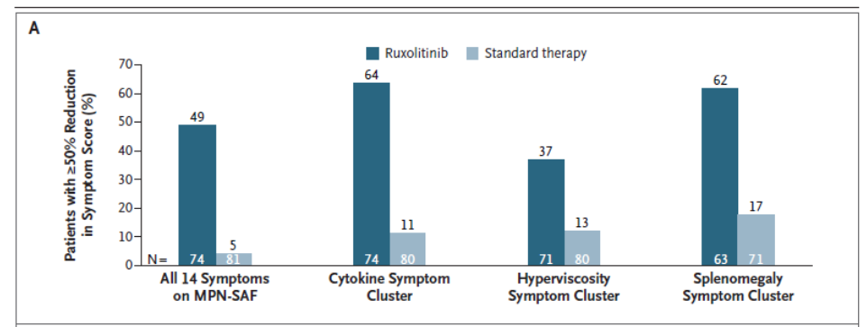
Improvement in symptoms
RESPONSE at Week 32
Percentage of Patients with a ≥ 50% Improvement in MPN-SAF Symptom Score at Week 32ª
      Vannucchi AM, et al. N Engl J Med. 2015;372(5):426-435.

Slide 15
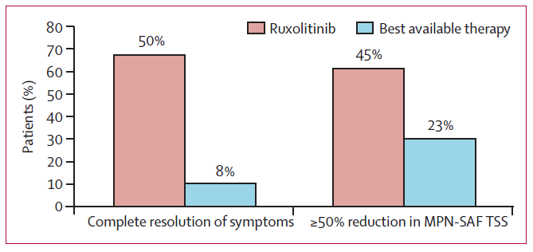
Improvement in symptoms
RESPONSE 2 at Week 28
MPN-SAF TSS: Myeloproliferative Neoplasm Symptom Assessment Form Total Symptom Score. *MPN-SAF TSS reduction of ≥10 points from baseline at week 16 and maintained until week 28 (for patients with a baseline score of ≥20; ruxolitinib, n=34; best available therapy, n=26)
Patients achieving complete resolution of
PV-related symptoms and ≥50% reduction in
MPN-SAF TSS at week 28 in RESPONSE 2
Passamonti F, et al. Lancet Oncol. 2017;18(1):88-99.

Slide 16
RESPONSE-2: Hematocrit control through Week 260
Durable Hct control in RUX patients
Primary response at Week 28ª
Hct control was achieved in both RUX and crossover patients
Durable Hct control at Week 260^{b} was achieved by 21.6% (16/74) of patients randomized to RUX
After crossover from BAT to RUX, median Hct levels declined by – 7.1% (– 28.0, 8.1) at EOT
KM plot for duration of Hct control
(Time from start of Hct control to phlebotomy eligibility, palpable spleen, transformation to MF or AML, or death)^{b}
100
80
60
Median Hct levels (%) over time
Time crossover group (study weeks)
56 68 92 116 140 164 188 212 236 260
50
0
28
RUX BAT
Crossover
Hematocrit (%)
45
Probability (%)
Hct threshold level for crossover to RUX
40
40
20
KM median duration of Hct control: RUX: not reached
BAT: not reported due to small number of patients responding to BAT
35
0
52
80 104 130 156 182 208 234
Time RUX and BAT groups (study weeks)
260
28
0
RUX
0
28
52
80 104 130 156 182 208 234 260
Time (study weeks)
N patients
RUX 73 67 66 65 67 65 63 61 64 61 63 63 60 61 58 58 58 55 54 56 52 40
BAT 74 71 70 67 24 16 11 6
Crossover 58 54 52 53 49 50 48 48 47 48 46 41 30 29 37 38 39 35 33 22
At risk 47 47 47 47
Events 0 0 0 0
47 43
0 4
40 36 35 35 35 33 31 30 29 29 28 27 27 26 25 10 0
7 10 11 11 11 13 15 16 17 17 18 19 19 19 19 20 20
ª Defined as absence of phlebotomy eligibility from Weeks 8 to 28, with only 1 post-randomization phlebotomy allowed prior to Week 8. ^{b} Defined as no phlebotomy eligibility starting at Week 8 and continuing through Week 260, with ≤1 post-randomization phlebotomy eligibility prior to Week 8. Phlebotomy eligibility was defined as confirmed Hct >45% and ≥3% higher than baseline, or >48%. ^{c} Defined as time from start of Hct control to earliest date of phlebotomy eligibility, palpable spleen (>0 cm), transformation to MF or AML, or death due to any cause.
7
RUX and BAT data based on full analysis set. Crossover data based on crossover set. AML, acute myeloid leukemia; EOT, end of treatment; Hct, hematocrit; KM, Kaplan-Meier; MF, myelofibrosis.
Poster presented at the 2020 ASH Annual Meeting & Exposition, held virtually on 5–8 December 2020

Slide 17
RESPONSE-2: complete hematologic remission (CHR) & JAK2^{V617F} allele burden
Duration of CHR in RUX patients
CHR = Hct control, WBC <10x10⁹/L, and platelets ≤400x10⁹/L; key secondary response at Week 28ª
RUX consistently reduced JAK2^{V617F} allele burden over time
Durable CHR at Week 260^{b} was achieved by 12.2% (9/74) of patients randomized to RUX
Median change at EOT in JAK2^{V617F} allele burden was –14.8% in RUX arm, and –13.5% in crossover arm
KM plot for duration of CHR
(Time from start of CHR to phlebotomy eligibility, palpable spleen, WBC
≥10x10⁹/L, platelets >400x10⁹/L, transformation to MF or AML, or death)^{c}
Median JAK2^{V617F} allele burden over time
100
RUX Crossover
BAT not reported due to small number of patients through Week 80
100
KM median duration of CHR: RUX: 34.0 weeks
BAT: not reported due to small number
Median JAK2^{V617F} allele burden
80
73
Probability (%)
80
58
of patients responding to BAT
60
53
52
60
46
43
42
44
40
39
₃₆ 39
34
39
37
40
28
31
28
27 27
20
20
0
RUX
0
0
28
52
80
104
130 156
182
208
234
260
BL
28
52
80
104 130
Time (study weeks)
156
182
208
234
 |  |  |  | Time (study weeks)
At risk | 18 18 14 11 | 7 7 | 6 5 | 5 5 4 4 4 4 3 3 | 3 3 | 3 2 | 2 1 | 0
Events | 0 0 4 7 | 11 11 | 12 13 | 13 13 14 14 14 14 15 15 | 15 15 | 15 15 | 15 15 | 15
RUX | 72 | 67 | 66 | 65 | 65 | 61 | 57 | 58 | 53 | 52
Crossover | - | 57 | 49 | 40 | 44 | 44 | 44 | 38 | 35 | 37
ª Defined as HcT control, WBC <10x10⁹ /L, and platelets ≤400x10⁹/L, at Week 28. ^{b} Defined as Hct control at Week 260 (absence of phlebotomy eligibility starting at Week 8 through Week 260, with ≤1 post-randomization phlebotomy eligibility prior to Week 8, WBC <10 x10^⁹/L at Week 260, and Platelets ≤400 x 10^⁹/L at Week 260. ^{c} Defined as time from start of CHR to earliest date of phlebotomy eligibility, palpable spleen (>0 cm), WBC ≥10x10⁹ /L, platelets >400x10⁹/L, transformation to MF or AML, or death due to any cause. RUX and BAT data based on full analysis set.
Crossover data based on crossover set. AML, acute myeloid leukemia; CHR, complete hematologic remission; KM, Kaplan-Meier; MF, myelofibrosis; WBC, white blood cell count.
Poster presented at the 2020 ASH Annual Meeting & Exposition, held virtually on 5–8 December 2020

Slide 18
RESPONSE-2: PV-associated symptoms (MPN-SAF TSS)
Significant improvement in PV symptoms (MPN-SAF TSS) with RUX vs BAT
60
53
51
49
53
Proportion of patients with ≥50% reduction in MPN-SAF TSS from baseline
50
48
49
47
47
48
48
47
44
45
45
44
44
44
45
42
40
40
28
31
30
RUX
BAT
21
22
20
17
16
10
0
4
8
16
28
40
52
80
92
104
117 130
Time (study weeks)
143
156
169
182
195
208
221
234
247
RUX | 30/68 | 36/68 | 34/67 | 29/65 | 32/67 | 34/70 | 30/67 | 28/64 | 30/68 | 28/64 | 30/64 | 30/64 | 31/65 | 29/64 | 31/63 | 29/61 | 29/55 | 23/55 | 23/57 | 24/51
BAT | 12/70 | 11/69 | 14/67 | 5/23 | 5/18 | 4/13 | 0 | 0 | 0 | 0 | 0 | 0 | 0 | 0 | 0 | 0 | 0 | 0 | 0 | 0
At EOT, 45.2% (28/62) patients randomized to RUX achieved ≥50% reduction in MPN-SAF TSS from baseline vs 15.9% (10/63) of patients randomized to BAT
o Difference RUX vs BATª: 29.3% (95% CI 14.0, 44.6)
Odds ratio ≥50% reduction MPN-SAF TSS (RUX/BAT):
o 4.36 (95% CI 1.88, 10.12)
ª Crossover patients not included. RUX and BAT data based on full analysis set.
CI, confidence interval; EOT, end of treatment; MPN-SAF TSS, Myeloproliferative Neoplasm Symptom Assessment Form total symptom score.
Poster presented at the 2020 ASH Annual Meeting & Exposition, held virtually on 5–8 December 2020

Slide 19
Response-2: Adverse events at 5 years
 | RUX (N=74) |  | BAT (N=75) |  | Crossover (N=58)
Median (range) exposure | 260.0 (0.1– 273.1) weeks |  | 28.4 (6.7– 83.0) weeks |  | 224.7 (2.7– 236.1) weeks
Patient-year (PY) exposureª | 334.27 days |  | 53.35 days |  | 205.96 days
 | Any Grades, n (rate/100 PY) | Grade 3/4, n (rate/100 PY) | Any Grades, n (rate/100 PY) | Grade 3/4, n (rate/100 PY) | Any Grades, n (rate/100 PY) | Grade 3/4, n (rate/100 PY)
Any AE | 74 (22.1) | 50 (15.0) | 64 (120.0) | 22 (41.2) | 57 (27.7) | 33 (16.0)
AEs of special interest
Thromboembolic events (TEE) | 5 (1.5) | 4 (1.2) | 2 (3.7) | 0 | 6 (2.9) | 3 (1.5)
Herpes zoster | 13 (3.9) | 3 (0.9) | 0 | 0 | 8 (3.9) | 0
Malignant tumors | 15 (4.5) | 7 (2.1) | 4 (7.5) | 3 (5.6) | 9 (4.4) | 5 (2.4)
Non-melanoma skin cancer (NMSC) | 9 (2.7) | 4 (1.2) | 1 (1.9) | 0 | 6 (2.9) | 2 (1.0)
Myelofibrosis | 2 (0.6) | 0 | 1 (1.9) | 1 (1.9) | 1 (0.5) | 0
Deaths | 1 (1.4) |  | 1 (1.3) |  | 3 (5.2)
Safety profile was consistent with previous reports of RUX
The most common AEs (>5%, exposure adjusted rate) associated with RUX were anemia, arthralgia, and increased weight in the RUX arm, and anemia and hypertension in patients after crossover
Exposure-adjusted TEE rate (any Grade) was ~2.5x lower with RUX vs BAT, and ~2x lower with early RUX vs delayed RUX initiation
Exposure-adjusted rates for NMSC were similar between crossover and RUX patients
ª Defined as sum of each patient's exposure in days, divided by 365.25.
Safety set. AE, adverse event; PY, patient-years; NMSC, Non-melanoma skin cancer; TEE, thromboembolic events.

Slide 20
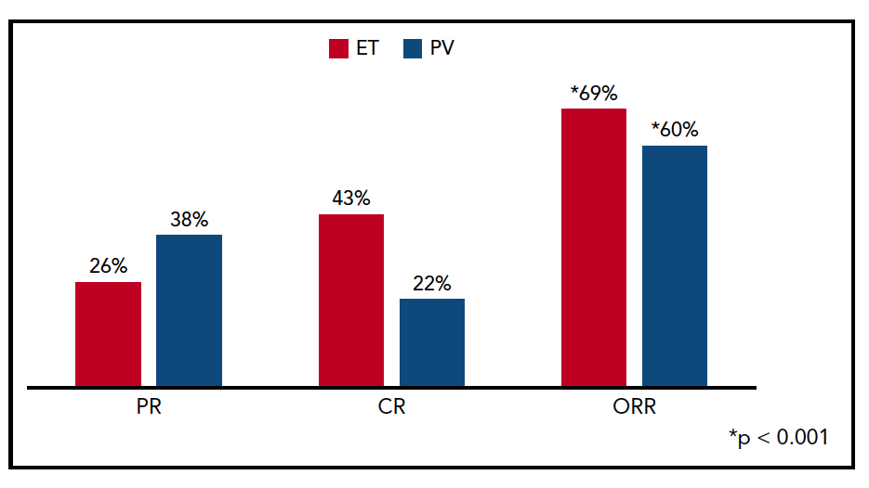
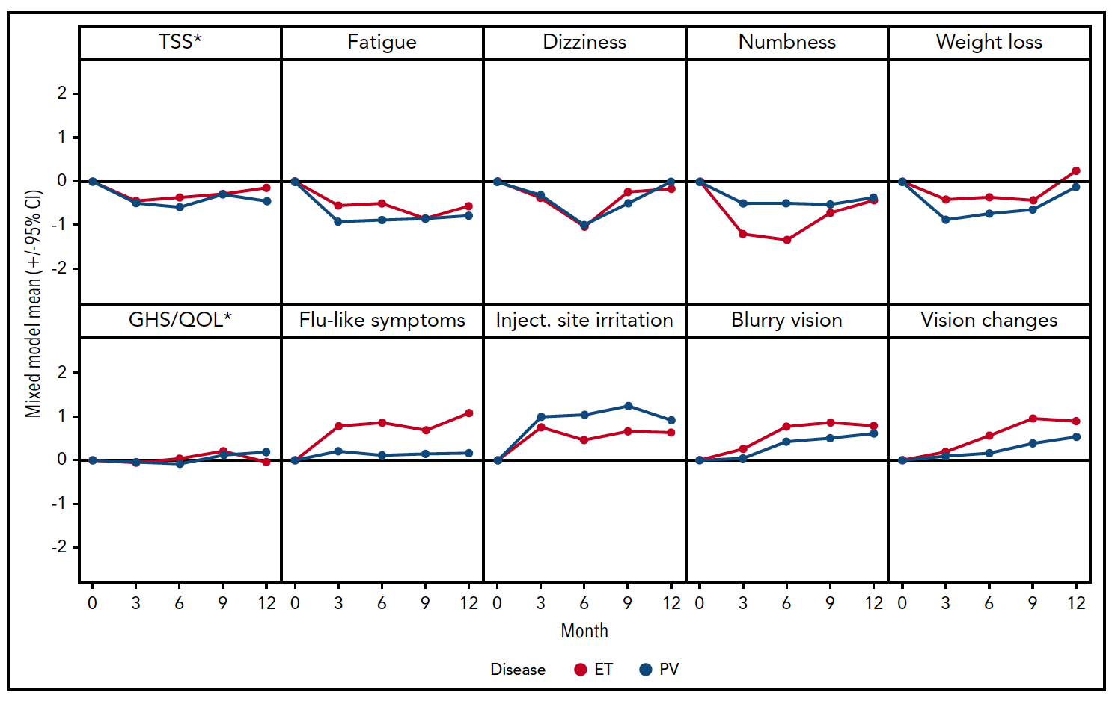
Pegylated IFN second line after resistance and/or intolerance to hydroxyurea
50 patients with PV.
The ORR (CR/PR) after 1 year was 60% in PV patients
Only 14% of patients discontinued for adverse events
JAK2 VAF decrease was observed mostly in patients with CR
Yacoub et al Blood 2019

Slide 21
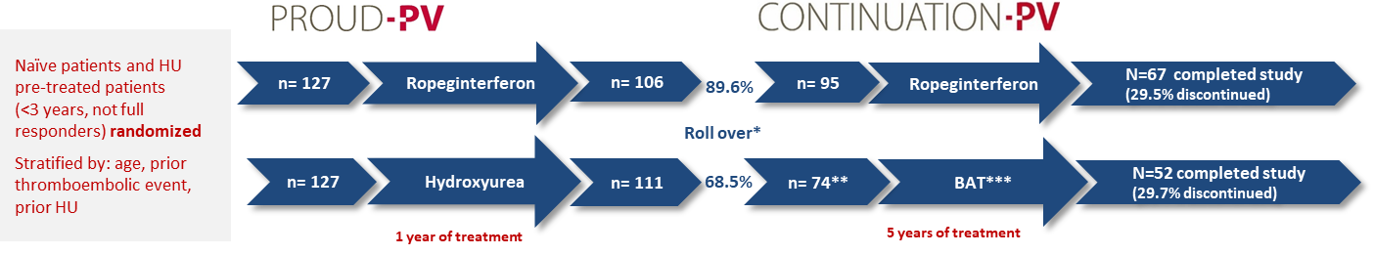
Phase III studies PROUD-PV and CONTINUATION-PV^{1,2}:
Design and patient disposition (final data)
72 MONTH FINAL ANALYSIS:
Efficacy data up to month 72
All safety data up to database lock in July 2021 (up to 7.3 years of treatment overall)
*There were no significant differences between patients who entered CONTINUATION-PV study and those who did not roll-over **Full analysis set (76 were enrolled, two of whom were excluded)***Control group received best available treatment (BAT); 88% of patients received HU as of month 72
¹Gisslinger et al. HemaSphere 2022; 6:97-98 (Link)
²Gisslinger et al. Leukemia 2023; doi: 10.1038/s41375-023-02008-6 (Link)
21
Notes:
The first randomised, controlled, phase 3 trials comparing interferon alfa with hydroxyurea in patients with polycythaemia vera. I pz andavano a visita ogni 3 mesi.
2013-2014→2021

Slide 22
Complete hematologic response (CHR)^{1,2,3}
Full analysis set
Definition of CHR:
  Hct<45% and no phlebotomy for at least 3 months
  PLTs<400 x 10⁹/L
  WBCs<10 x 10⁹/L
Discontinued patients were counted as non-responders
Study Month | Responder/N | Responder % | Responder/N | Responder % | P-value | RR [95% CI] (AOP2014/Control)
 | Ropeg IFN (N=95) |  | Control (N=74)
MONTH 12 (EOT in PR) | 59/95 | 62.1% | 56/74 | 75.7% | 0.0850 | 0.84 (0.69 to 1.02)
MONTH 24 | 67/95 | 70.5% | 31/65 | 47.7% | 0.0110 | 1.44 (1.09 to 1.91)
MONTH 36 | 67/95 | 70.5% | 38/72 | 52.8% | 0.0208 | 1.33 (1.04 to 1.71)
MONTH 48 | 57/94 | 60.6% | 33/74 | 44.6% | 0.0283 | 1.39 (1.04 to 1.87)
MONTH 60 | 53/95 | 55.8% | 33/73 | 45.2% | 0.1390 | 1.26 (0.93 to 1.71)
MONTH 72 | 48/88 | 54.6% | 22/63 | 34.9% | 0.0216 | 1.55 (1.07 to 2.26)
¹Gisslinger et al. Blood 2020; 136:33 (Link)
²Kiladjian et al. Leukemia 2022; 36:1408-1411 (Link)
³Gisslinger et al. Leukemia 2023; doi: 10.1038/s41375-023-02008-6 (Link)
22
Notes:
Hanno discontinuato 25 pz nel braccio sperimentale vs 20 nel braccio BAT
Il 68% vs 40% aveva risposta ematologica

Slide 23
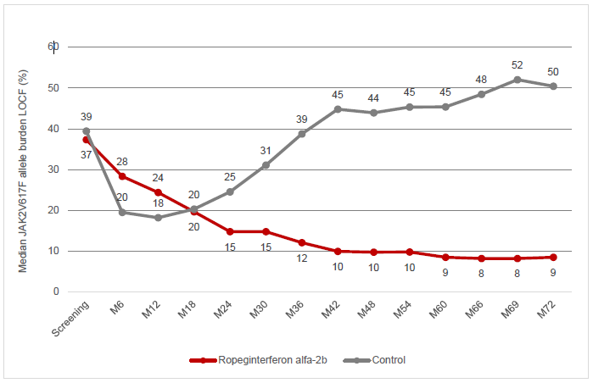
PROUD/CONTI-PV: Median JAK2V617F allele burden (LOCF)¹
Il carico allelico mediano di JAK2V617F al mese 72 era dell’8,5% contro il 50,4% rispettivamente nel braccio di Ropeginterferon alfa-2b e nel braccio di controllo (p < 0,0001).
Al 6° anno di trattamento un carico allelico >50%, è stato riscontrato solo nell’11,6% dei pazienti nel braccio sperimentale nel rispetto al 50,0% dei pazienti trattati con HU/BAT (p < 0,0001).
Study Month | Ropeg IFN (N=95) |  | Control (N=74) |  | p-value | RR [95% CI] (AOP2014-Control)
 | Mean | Median | Mean | Median
Baseline | 42.8 | 37.3 | 43.4 | 39.4 | - | -
MONTH 12 (EOT in PR) | 30.2 | 24.4 | 24.4 | 18.2 | 0.0212 | 6.947 (1.039 to 12.854)
MONTH 24 (LOCF) | 21.0 | 14.8 | 32.0 | 24.5 | 0.0010 | -9.913 (-15.798 to -4.029)
MONTH 36 (LOCF) | 19.9 | 12.1 | 38.8 | 38.7 | <0.0001 | -17.744 (-23.628 to -11.859)
MONTH 48 (LOCF) | 19.3 | 9.8 | 44.1 | 43.9 | <0.0001 | -23.694 (-29.578 to -17.809)
MONTH 60 (LOCF) | 18.9 | 8.5 | 45.4 | 45.4 | <0.0001 | -24.891 (-30.776 to -19.006)
MONTH 72 (LOCF) | 19.0 | 8.5 | 48.0 | 50.4 | <0.0001 | 27.734 (-33.619 to -21.850)
¹ Gisslinger et al. Leukemia 2023; doi: 10.1038/s41375-023-02008-6 (Link) See the supplement for this figure
23
Notes:
Last observation carried forward: metodo per gestire i dati persi in studi longitudinali (ripetute osservazioni dello stesso parametro in un lungo periodo di tempo)

Slide 24
Adverse drug reactions of special interest to IFN therapy¹
Disorders by system organ class | N (%) in ropegIFN arm
Endocrine | 6 (4.7%)
Autoimmune thyroiditis Hypothyroidism Hyperthyroidism | 2 (1.6%) 4 (3.1%) 1 (0.8%)
Psychiatric | 1 (0.8%)
Depression, anxiety, altered mood, nervousness | 1 (0.8%)
Musculoskeletal /connective tissue | 2 (1.6%)
Rheumatoid arthritis Sjögren syndrome | 1 (0.8%) 1 (0.8%)
Cardiac | 1 (0.8%)
Intracardiac thrombus | 1 (0.8%)
Skin/subcutaneous tissue | 2 (1.6%)
Dermatitis acneiform Psoriasis | 1 (0.8%) 1 (0.8%)
Immune system / blood and lymphatic system | 1 (0.8%)
Sarcoidosis | 1 (0.8%)
Congenital, familial, genetic | 1 (0.8%)
Non-acute porphyria | 1 (0.8%)
Investigations | 1 (0.8%)
Increased antinuclear antibody | 1 (0.8%)
In ropeginterferon-treated patients (N=127)
*Treatment related AEs of special interest to IFN therapy as assessed by the Investigator. Thromboembolic events are reported separately.
Unpublished data (72 months), on file
24

Slide 25
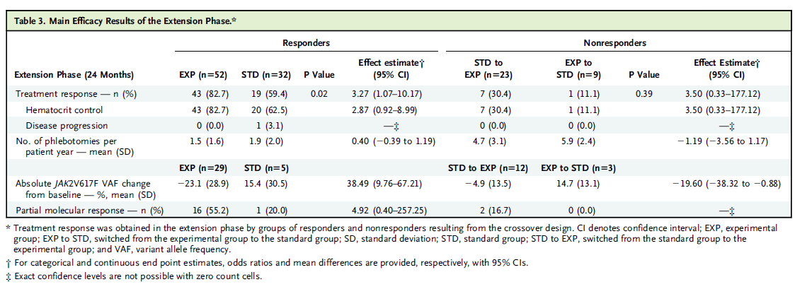
LOW - PV Study
Risultati a 24 mesi
Risposta modesta nel sottogruppo di pazienti che sono passati da EXP to STD: necessità di dosi di ROPEG più elevate per essere efficace, come nel PROUD/CONTINUATION study?
1 progressione di malattia nel gruppo STD:
Trombocitosi progressiva e sintomi microvascolari
Barbui et al. NEJM 2023
Notes:
- At 24 months, the composite treatment response was confirmed in 43 of 52 (83%) and 19 of 32
- Changes in JAK2V617F allele burden from baseline to 12 and 24 months were assessed in 98 and 49 patients, respectively (Tables 2 and 3). Ropeg-treated patients showed a change of JAK2V617F variant allele frequency (VAF) from baseline to 12 and 24 months (211.9% and 223.1%, respectively); this was more marked in patients with baseline VAF levels of more than 50% (Fig. S4). JAK2V617F VAF remained substantially unchanged in the standard group.
- Patients who had not reached the primary end point at 12 months (nonresponders) crossed over to standard (n9) or ropeg (n23) therapy. Of the patients who crossed over to ropeg, 7 of 23 (30%) met the composite response in the subsequent 12 months. These patients received 4.7 phlebotomies
per patient per year; in contrast, patients receiving ropeg over the first 12 months from randomization received 2.9 phlebotomies per patient per year.

Slide 26
Conclusions
Unmet need in PV patients resistant and/or intolerant to current treatments
Importance to early identify patients who deserve a switch of treatment
Current second line treatment: IFN or ruxolitinib
New agents still under investigation

Slide 27
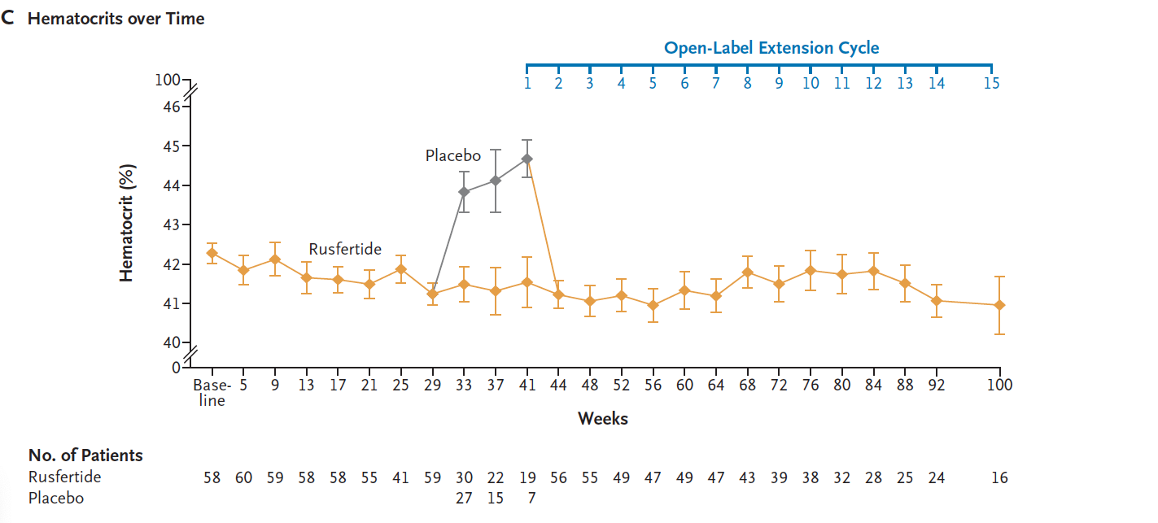
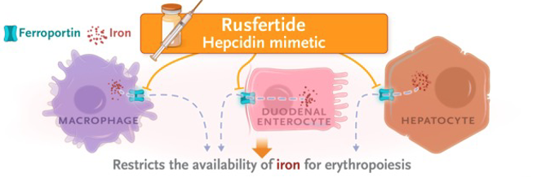
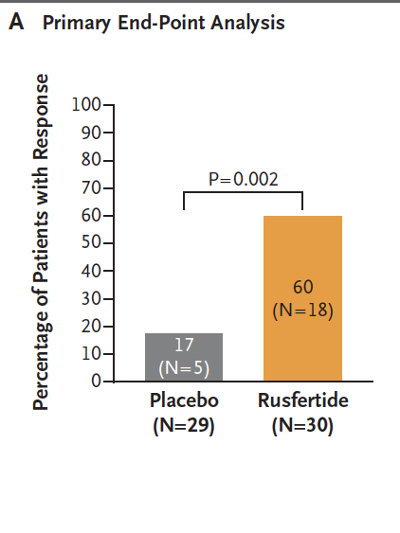
Rusfertide in PV: efficacy and safety
70 patients with PV during current available treatment.
Rusfertide was administered sc weekly with a dose ranging 10-120 mg
All patients in the second part of the trial had a hematocrit control
and increased level of ferritin
More common side effects were fatigue and injection side reaction,
pruritus, nausea but very few of grade 3
Kremyanskaya et al Nengl J Med 2024

Slide 28
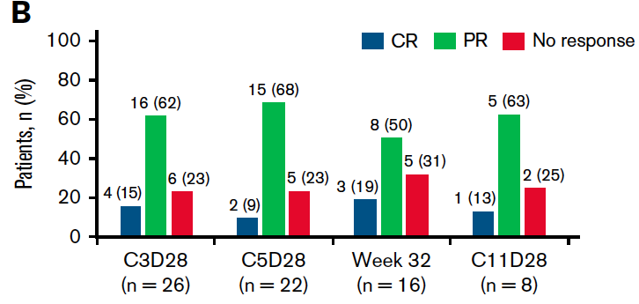
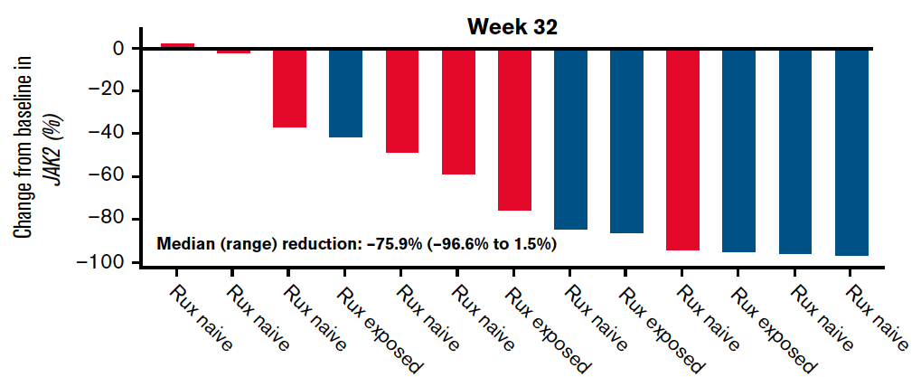
Idasanutlin (MDM2 inhibitor) in PV: efficacy and safety
27 patients enrolled in a phase 1 study after resistant/intolerance to HU
Primary endpoint: CHR and reduction of splenomegaly (SVR>35%)
69% of pts with splenomegaly achieved the endpoint with 1 in CHR
56% of pts achieved hematocrit control with 50% in CHR
43% of pts achieved TSS >50%
More common AE : nausea, diarrhea, vomiting
Mascharenas et al Blood adv 2021

Slide 29
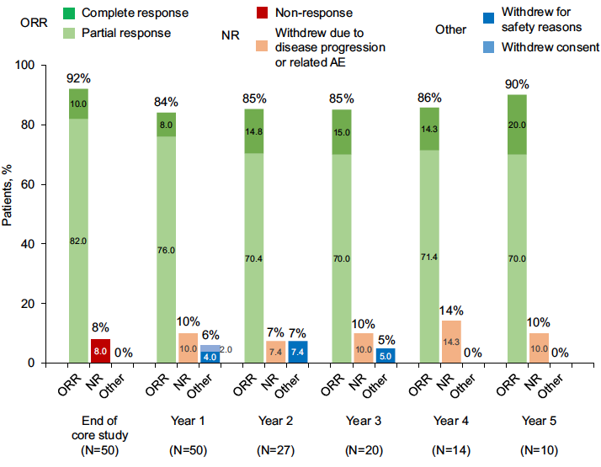
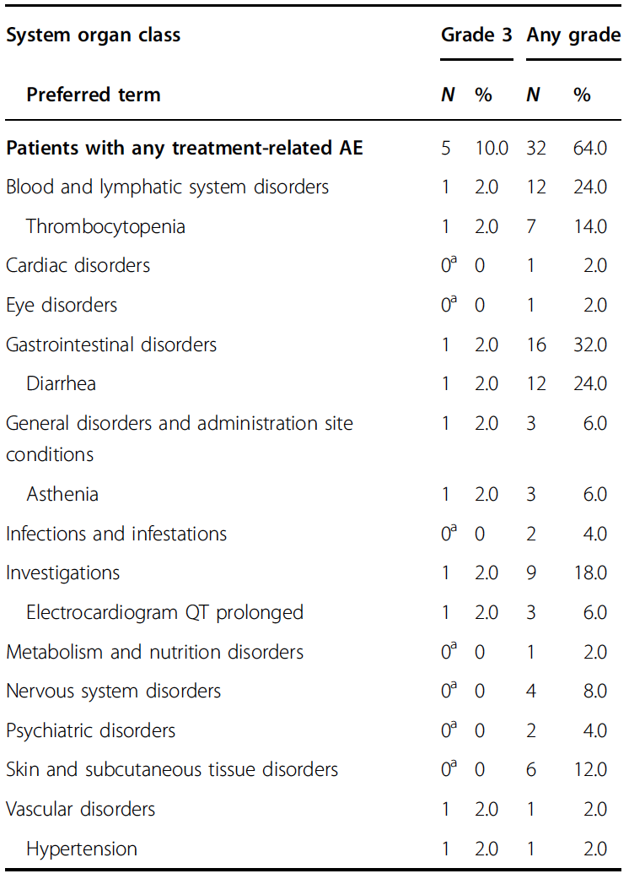
Givinostat (histone-deacetylase inhibitor) in PV: efficacy and safety
51 patients enrolled with mean 4-years of FU
ORR greater than 80%
Only 10% of pts reported grade 3 adverse events
Rambaldi et al Blood Cancer J 2021

